Slide 1
Calalogue

Slide 2
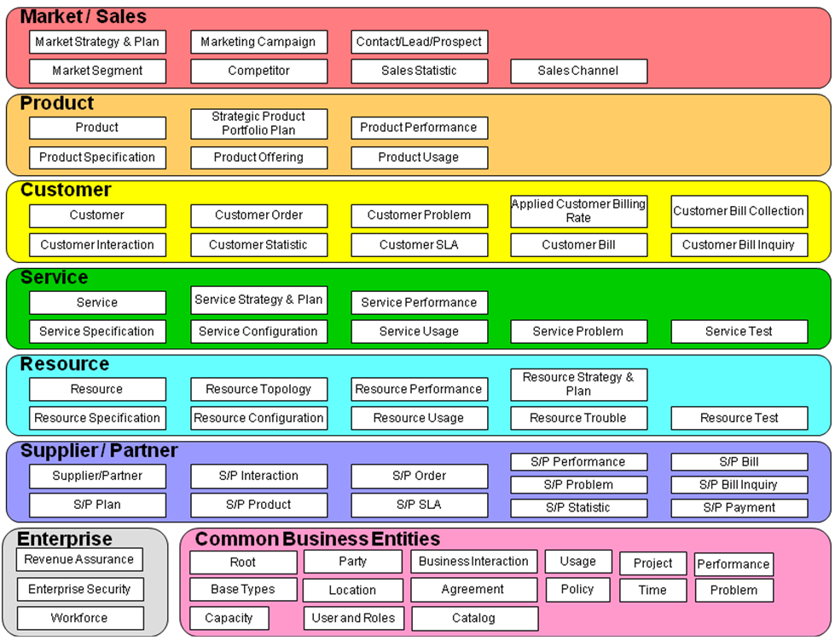
SID framework Catalogue Entry

Slide 3
Product/Product Catalog
A ProductCatalog is a collection of ProductOfferings, intended for a specific DistributionChannel, enhanced with additional information such as SLA parameters, invoicing and shipping details. As described in the Products addendum document, each ProductOffering in a ProductCatalog combines pricing and availability information with ProductSpecifications that describe the relationships between Products, the Services used to realize the Products, and the Resources they require.
A service provider may choose to present its ProductOfferings to multiple audiences through multiple channels. Therefore, although the collection of all available ProductOfferings may be considered “the” ProductCatalog, the information model should support the definition and differentiation of multiple ProductCatalogs, containing possibly overlapping subsets of the ProductOffering universe. This support is provided by the use of the EntitySpecification/Entity pattern used elsewhere in the SID.

Slide 4
Service Catalog
A service catalog is a group of Service Specifications made available through Service Candidates that an organization provides to the consumers (internal consumers like its employees or B2B customers or B2C customers). A service catalog typically includes name, description and time period that is valid for. It will have a list of Service Candidates. A Service Candidate is an entity that makes a Service Specification available to a catalog. A Service Candidate and its associated Service Specification may be “published” – made visible – in any number of Service Catalogs, or in none. One Service Specification can be composed of other Service Specifications. These Service Specifications may also be published. Attributes affecting that association, such as the time period during which a Service Candidate is valid in a particular Service Catalog, are contained in the association class Serv Catalog Serv Candidate.

Slide 5
Resource Catalog
A Resource Catalog is a list of Resource Specifications made available through Resource Candidates that an organization will provide it to its consumers (internal or external). Not all Resource Candidates are made available to a consumer. A Resource Catalog typically includes name, description and time period that it is valid for. It will have a list of Resource Candidates. A ResourceCandidate is an entity that enables the ResourceSpecifications to a catalog. A ResourceCandidate and its ResourceSpecification may be “published” – made visible – in any number of ResourceCatalogs, or in none. One ResourceSpecification can be composed of other ResourceSpecifications. These ResourceSpecifications may also be published. Attributes affecting that association, such as the time period during which a ResourceCandidate is valid in a particular ResourceCatalog, are contained in the association class ResCatalogResCandidate.

